Slide 1
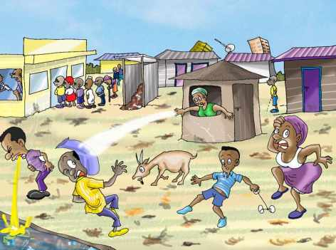
Water Sector Trust Fund
Sanitation Marketers Training Workshop
What is public health?
Public health & sanitation
Facts about sanitation
Sanitation marketing meets
public health

Slide 2
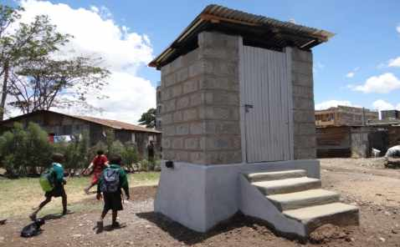
Focus of Public Health
The focus of public health intervention is to improve health and quality of life through the prevention and treatment of disease and other physical and mental health conditions, through surveillance of cases and health indicators, and through the promotion of healthy behaviors.

Slide 3
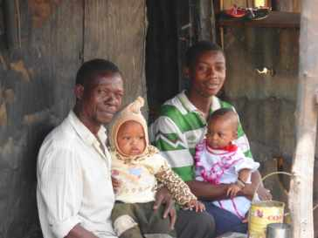
Link between sanitation and public health
According to the World Health Organisation (WHO):
  "Sanitation generally refers to the provision of facilities and services for the safe disposal of human urine and feaces. Inadequate sanitation is a major cause of disease world-wide and improving sanitation is known to have a significant beneficial impact on health, both in households and across communities....”
  Therefore, with improved sanitation, there is improved health of the public in general hence promoting a healthy community as a whole

Slide 4
Facts about sanitation that affect (public) health
Lack of clean water and poor and dirty toilets cause many diseases and the spread of diseases
One important disease that arise from poor and dirty toilets is diarrhoea
In Kenya (in 2010) approximately 11,000 children died of diarrhoea (30 children every day)
Poor and dirty toilets also cause other diseases such as cholera, dysentery, typhoid and hepatitis A
Many studies show that good & clean toilets reduce the number of deaths caused by diarrhoea and other diseases
That is why:
Good & clean toilets are very important in order to keep good health
Using safe water & good hygiene (hand washing) are essential to good health

Slide 5
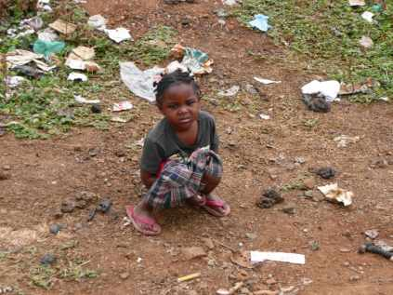
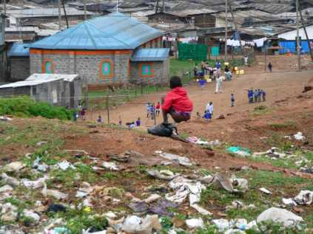
Sanitation Marketing meets Public Health
According to WHO and UNICEF:
“69% of Kenyans living in low income areas do not have access to improved sanitation facilities. This further contributes to the prevailing diseases and the poor living conditions.” (April, 2013)

Slide 6
Sanitation Marketing meets Public Health
Residents may not be aware that poor sanitation may lead to diseases and ultimately death. However …even if they know they may not have the money to construct good toilets
Making people aware of the importance of good sanitation is done through awareness creation focusing on:
health risks dirty toilets, no hand washing, poor handling of solid waste)
solutions better affordable toilets, keeping toilets clean, hand washing
What is needed? A sanitation marketing approach that not only focuses on marketing good and affordable toilets but also provides behavior change messages

Slide 7
What does UBSUP Sanitation Marketing target?
The sanitation marketing component in the UBSUP/SafiSan programme aims at not only creating awareness on the need for better and improved sanitation, but also offers sanitation facilities (good and affordable toilets) that meet the needs and wishes of the consumers
The toilets should also have the attributes that enable and promote effective use (easy to clean surfaces, a manual, a hand washing facility, etc.)
The toilets should appeal to the consumers so they can even promote their new toilet
The toilet should have good quality according to the standards given
Good toilets, with the attributes consumers want, will lead to more sales, improved sanitation and better health
Sanitation Marketers will be concerned in passing this message forward to the target audiences

Slide 8
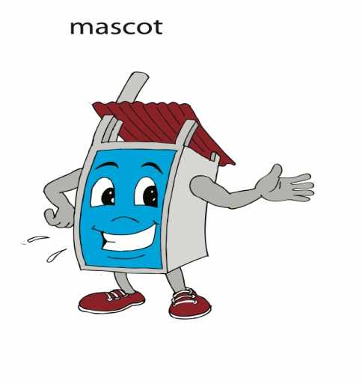
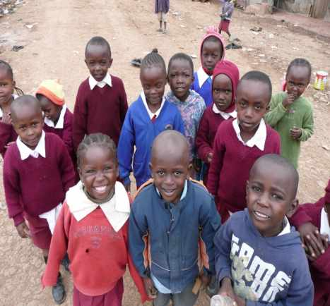
THANK YOU
Sanitation is every Kenyan’s right.........

